Slide 1
Sustainability at the Department of Energy
John Shonder, Director
DOE Sustainability Performance Office
May 21, 2015

Slide 2


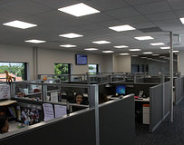
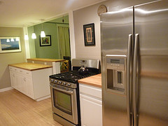

DOE working on numerous fronts to help build a clean energy future
Overall Mission: Ensure America’s security and prosperity by addressing energy, environmental, and nuclear challenges through transformative science and technology solutions
  Increase efficiency, reduce manufacturing cost, and increase the share of energy coming from renewable sources
  Increase efficiency, reduce emissions from conventional power sources
  Increase efficiency of lighting, HVAC, appliances, manufacturing processes, transportation, etc.

Slide 3
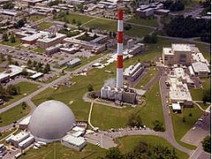
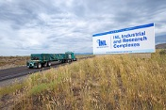
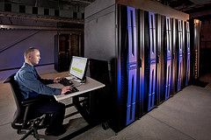
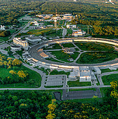
Sustainability is how we as a Department lead by example
Our contribution to the clean energy future
  Reduce energy use
  Reduce water use
  Increase the use of renewable energy
  Reduce greenhouse gas emissions
Our response as a Department – and as individuals – to global climate change

Slide 4
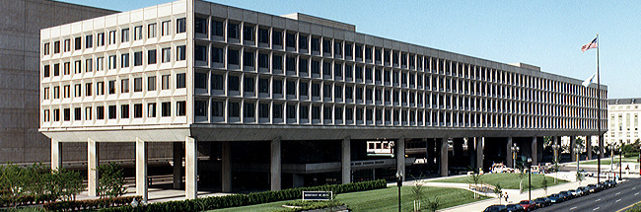
DOE: Operations
Employs approximately 109,000 people
Operates 47 major sites, which include laboratories, accelerators, manufacturing and processing plants, test facilities, and office buildings
Operates over 14,000 vehicles
Spent more than $370 million on facility energy and water consumption in FY 2014
Notes:
Employees from DOE Agency Financial Report
FY 2013: 115,546 (contractor + federal)
FY 2014: 109,160 (contractor + federal)
$370 million is all utility costs, but does not include “Non-Fleet Vehicles and Equipment”. Non-Fleet V&E does include some generators that are used at facilities, but mostly its heavy machinery like at Hanford. Also does not include renewables. Cost of renewables for FY14 was not available during the time of this presentation.

Slide 5
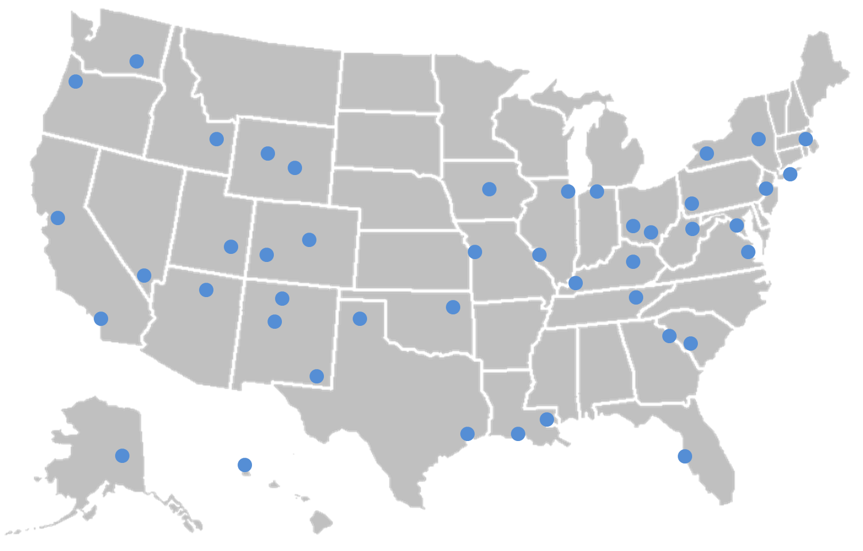
Department of Energy Sites
Notes:
Locations of DOE sites, offices, and laboratories.

Slide 6
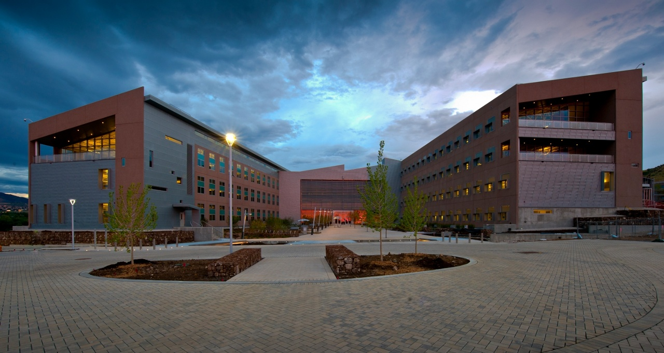
The DOE Footprint
3rd largest user of facility energy in the Federal Government, 4th largest in total energy use
In FY 2013, DOE used, occupied and emitted approximately:
  28.9 trillion Btus total energy; 3% of Government total
  4.9 million MWH electricity; 9% of Government total
  6.5 billion gallons of potable water; 5% of Government total
  120 million square feet; 4% of Government total
  3.1 million MTCO₂e Scope 1& 2 GHG; 7% of Government total
Notes:
Total Energy use: 1) DOD, 2) Postal, 3) VA, 4) DOE (DOE 3% of total)
Facility Energy use 1) DOD, 2) VA, 3) DOE (DOE 7.5% of total)
All data from FEMP; http://ctsedwweb.ee.doe.gov/Annual/Report/Report.aspx
No new FY14 data from FEMP
FY14 Data from Dashboard:
29.2 trillion Btus total energy (calculated independently using dashboard data)
5.03 million MWH electricity
5.9 billion gallons of potable water
103 million sq. ft
3.1 million MTCO2e Scope 1& 2

Slide 7
Sustainability Roles / Responsibilities
Chief Sustainability Officer (CSO)
  Leads DOE Sustainability efforts
  Chairs DOE Senior Sustainability Steering Committee and makes related policy decisions
  Provides guidance to SPO and submits official reports/plans
Under Secretaries / HQ Elements
  Responsible for meeting, funding, and reporting on SSPP goals
  Partners with sites and labs to meet goals
  Reports to SPO and partners on progress and projections
Sustainability Performance Office (SPO)
  Facilitates coordination of DOE sustainability efforts
  Performs data collection, analysis, and reporting
  Issues policies and guidance
  Leads agency coordination and interagency representation

Slide 8
Principal Products of the Sustainability Performance Office
Strategic Sustainability Performance Plan
Comprehensive Greenhouse Gas Inventory
OMB Scorecard
Climate Adaptation Plan
Fleet Alternative Fuel Vehicle Acquisition Report
EISA Section 432
President’s Performance Contracting Challenge

Slide 9
Principal Driver: E.O. 13693
Establish new GHG reduction targets for FY25 (FY08 baseline)
Reduce energy use intensity 2.5 percent annually through FY25 (FY15 baseline)
Establish new High Performance Sustainable Buildings (HPSB) target for FY25
Establish net-zero building target for FY25
Utilize 25 percent clean energy (renewable and alternative) as a percentage of total electric and thermal use by FY25
Utilize 30 percent renewable energy as a percentage of total electric energy use by FY25
Reduce fleet-related GHGs 30 percent by the end of FY25 (FY14 baseline)
Reduce water use intensity 36 percent by FY25 (FY07 baseline)
Fulfill existing agency target for performance contracting (DOE: $275 million by December 2016) and establish new annual targets for FY17 and thereafter

Slide 10
DOE Performance: Key Goals
 | Current Performance (FY14) | New Target (FY25)
Scope 1 & 2 GHG Emissions | -34% (FY08 baseline) | TBD* (FY08 baseline)
Scope 3 GHG Emissions | -24% (FY08 baseline) | TBD* (FY08 baseline)
Energy Intensity | -28% (FY03 baseline) | -25% (FY15 baseline)
Water Intensity | -27% (FY07 baseline) | -36% (FY07 baseline)
Renewable Electric Energy | 19.5% | 30%
HPSB | 4.7% | TBD*
* DOE to set new targets for GHG emissions and HPSB
Notes:
Current performance pulled from DOE Sustainability Dashboard. Performance may be different from FEMP due to differences in data calculation.

Slide 11







FY 2014 CEQ/OMB Scorecard
 | Scope 1&2 GHG Emissions Reduction Target For Scope 1&2 GHG Reduction Target of 28% by 2020: 34.4% reduction and on track |  | Interim Target (FY14): -19%
 | Scope 3 GHG Emission Reduction Target For Scope 3 GHG Reduction Target of 13% by 2020: 19.3% reduction and on track |  | Interim Target (FY14): -5%
 | Reduction in Energy Intensity Reduction in energy intensity in goal-subject facilities compared with 2003: 27.4% reduction and on track for 30% by 2015 |  | Interim Target (FY14): -27%
 | Use of Renewable Energy Use of renewable energy as a percent of facility electricity use: Total of 18.3% from renewable electricity sources including at least 3.5% from new sources |  | Interim Target (FY14): 7.5%
 | Reduction in Potable Water Intensity Reduction in potable water intensity compared with 2007: 27.4% reduction and on track for 26% by 2020 |  | Interim Target (FY14): -14%
 | Reduction in Fleet Petroleum Use Reduction in fleet petroleum use compared to 2005: 18.7% reduction and not on track |  | Interim Target (FY14): -18%
 | Green Buildings Sustainable green buildings: 4.7% of buildings sustainable 5.6% GSF of inventory sustainable |  | Interim Target (FY14): 13%
Notes:
Data pulled from Sustainability Dashboard

Slide 12
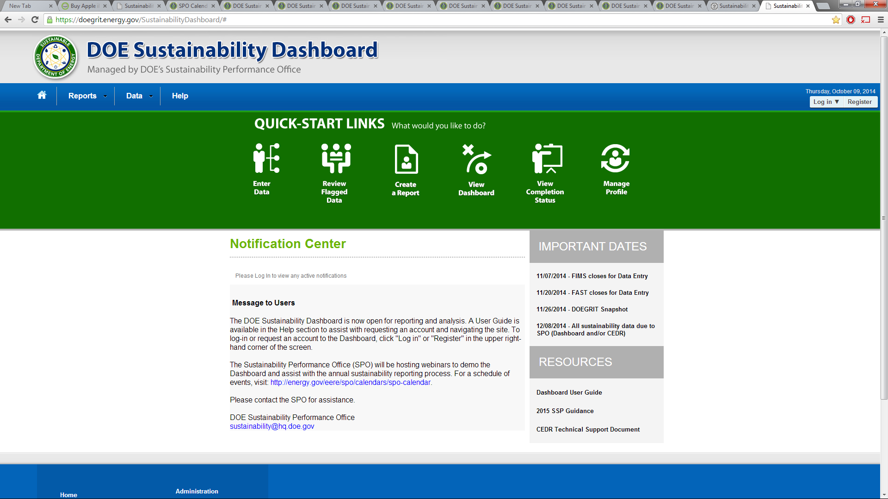
DOE Sustainability Dashboard
Notes:
The Sustainability Dashboard is online and will be used to gather data and will be instrumental in the future of DOE data compiling and reporting. It will be used to aid in the writing of the FY 2014 DOE SSPP.

Slide 13
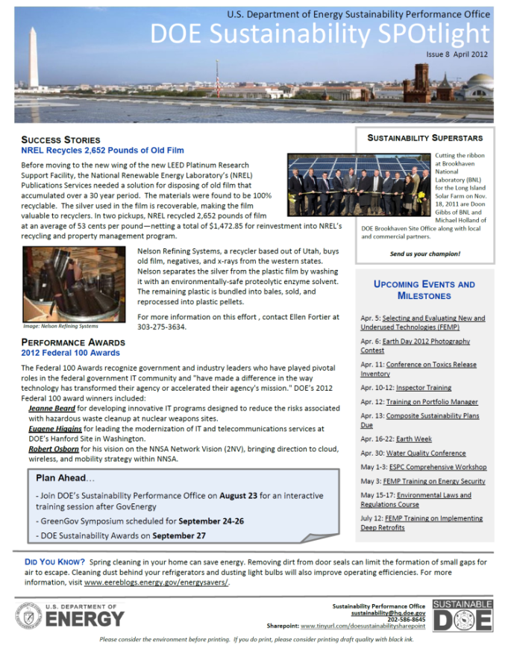
SPO Assistance and Activities
Provides technical assistance, best practices, and information resources
Issues guidance to meet requirements
Conducts data deep dives to better understand challenges and opportunities
Supports energy, water, and green building site assessments
Recognizes achievements
Shares information
To be added to the
SPO’s monthly newsletter,
email: sustainability@hq.doe.gov

Slide 14
Priorities and Upcoming Initiatives
Raise the profile of sustainability within DOE
Closer collaboration with Program Offices to identify needs and set priorities
Closer collaboration with FEMP and Office of Science programs to identify technologies that can be demonstrated at DOE sites
Better use of the data we collect through the Sustainability Dashboard to identify needs and set priorities
More direct investments in sustainability at DOE sites (current and future SPOFOAs)

Slide 15
Contact Information and References
Sustainability Performance Office:
http://www.sustainability.energy.gov
DOE SSPP:
http://www1.eere.energy.gov/sustainability/plans_reports.html
Comments, questions, and suggestions:
sustainability@hq.doe.gov

